Slide 1



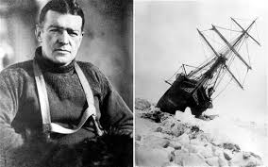
Maths
Multiplication and division, length and perimeter, facts, mass and capacity and fractions. The children will continue their times table fluency with an emphasis on rapid recall.
Geography
We will be exploring polar environments, biomes, sustainability and continents. We will compare continents and look at the survival of different animals like penguins. Children will understand longitude and latitude as well as climate zones.
History
We will be learning about
the explorer Shackleton
and the voyage the team
took. We will answer the
big question ‘why was
there a race?’ The children
will learn about recent
explorers and compare
their equipment to see
what has changed over
time.
Ice Explorers - Shackleton
English
We will be using persuasive features to write a letter of application. The children will learn about explanation features ready to write their own text on how to prepare for an expedition. Then, we will be writing a story about Antarctica using ‘Ice Trap’ as a model.
Science
During the first half of the Spring term we will be constructing simple circuits , exploring switches, insulators and conductors and finding out about electrical safety. After half term we will be exploring the role of the digestive system and comparing teeth and diets of different animals as part of a food chain.

Slide 2
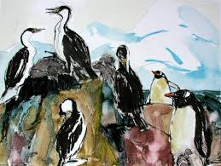

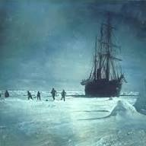
Art and design
Painting and mixed media will be our focus. We will learn about tints and shades, 3D effects and still life. We will learn about Frances Hatch and capture her impressions of Antarctica.
Computing
Continuing our coding with Scratch by understanding and creating variables. Data handling- using data to investigate the weather
PSHE
Safety and the changing body- online safety, reasons for age restrictions, road safety and first aid. Citizenship- rights of the child, our local community and recycling.
French
Zoo animals Numbers to 20 Parts of the body
Home learning
Reading- please read regularly with your children.
Times tables- TT Rockstars
Project grid- aim for at least 2 completed tasks across the term.
PE
Basketball and dance.
Music
Samba & carnival sounds.
Djenga drum workshop
DT
Wearable technology. Children will write a program that initiates a flashing LED panel, or another pattern.
RE
What kind of world did Jesus want? How and why do people try to make the world a better place?

