Slide 1

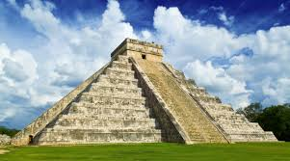
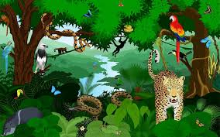
History
Children will sequence the key periods of the Ancient Maya civilisation then identify periods that were happening in Britain at the same time. They will explain how the Ancient Maya settled in the rainforest and the challenges they faced and describe Ancient Maya beliefs. We will name the features of the Ancient Maya cities and make deductions. We will explore and understand the importance of archaeologists, archivists and historians in constructing our understanding of the past.
Maths
The children will be exploring place value, rounding estimating, and roman numerals during the first half of the term. They will then begin to expand more formal written methods of addition and subtraction of 4-digit numbers.
We will finish the term with multiplication and division work exploring arrays, sharing, grouping and times tables
Geography
Children will explore state the location and some key features of the Amazon rainforest. They will learn to name and describe the four layers of tropical rainforests and understand that trees and plants adapt to living in the rainforest. We will define the word indigenous and give an example of how indigenous peoples use the Amazon’s resources. Children will explore deforestation and an action that can be taken to help.
The Ancient Maya
English
Children will be exploring the fiction text Rain player, and Charlie and the chocolate factory and non-fiction Mayan and rainforest books to sup[port narrative, myth, letter non-chronological report and poetry writing and reading comprehension.
Science
We will be exploring the role of skeletons and muscles, learning how the body uses energy and what constitutes a balanced diet.
In Autumn 2, we will learn about sound, volume, pitch and how sound travels.

Slide 2
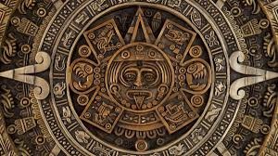
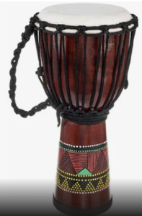
Art and design
In this unit, children will describe objects, images and sounds , Create drawings that replicate a selected image and select imagery and colours to create a mood board with a defined theme and colour palette. They will explore the work of William Morris, then use their sketch books to evaluate patterns. They will follow instructions to create a repeating pattern, adding extra detail and understand different methods of creating printed fabric in creative industries
PSHE
Building on their understanding of relationships and friendships, pupils will deepen their knowledge of boundaries, the impact of bullying, and diverse family structures. In the second half of the term the children will create a healthy diary, where energetic activities and high-energy food are scheduled for the same day and understand the benefits of healthy eating and dental health
Computing
The children will learn how to stay safe online by adjusting privacy settings to protect personal information, identifying fake news and developing ways to deal with upsetting content. The children will explore Scratch by programming an animation and improving it through testing and debugging.
PE
Football, tag rugby, Gymnastics and bean bag Bocca
DT
Home learning
Reading- please read regularly with your children.
Times tables- TT Rockstars
Project grid- aim for at least 2 completed tasks across the term.
French
Introductions Numbers to 12
Children will learn that fruits and vegetables grow in different countries based on their climates. They will understand that l fruits and vegetables are seasonal and that eating seasonal fruit and vegetables positively affects the environment.
The hildren will design a tart recipe using seasonal ingredients.
RE
The children will study a number of religions and identify where, how and why people worship. In the second half of the term the children will explore religious festivals and their meanings.
Music. Body and tuned percussion- rainforests and Christmas carols

